Slide 1

Go, Change the World

Slide 2
UNIT-I

Slide 3
Content
Introduction to CPS
CPS Concepts and Requirements
CPS Architecture
CPS Applications
CPS for Vehicular Environment
CPS for Agriculture
CPS for Health and Medical Sciences
CPS for Smart Grids
Future Aspects of CPS
Challenges and Opportunities

Slide 4
Introduction to CPS
Definition -1: CPS is an integration of networked, computational devices with physical process
Definition -2: CPS are physical and engineered systems whose operations are monitored, coordinated, controlled and integrated by the computation and communication
Definition -3: CPS is a communication-enabled embedded systems, which monitor and control the physical processes and the computerized system is closely and seamlessly
CPS = Networking Devices + Computational Devices + Physical Devices

Slide 5
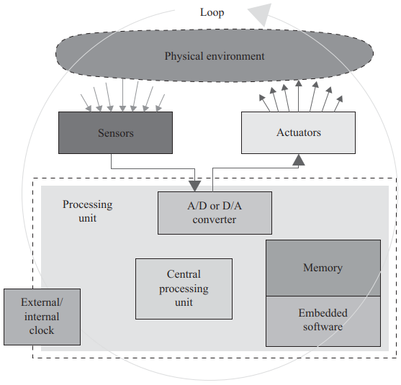
Introduction to CPS (Contd.)
Embedded Systems
An embedded system is a computer system—a combination of a computer processor, computer memory, and input/ output peripheral devices
The embedded systems are real-time and often use specialized networking technologies
An embedded system interacts with the physical process or environment and reacts accordingly.
Figure. Embedded System

Slide 6
Introduction to CPS (Contd.)
It is designed for dedicated application(s), a specific subsection of an application or product or part of a larger system.
Successful applications include aircraft control systems, automotive electronics, home appliances, weapons systems, games, toys and so on.
The information about the physical environment is gathered by the system through sensors, either continuously or periodically.
Sensed information is provided through the analog-to-digital (A/D) converters. The embedded software residing in the memory processes this information and sends instructions to the actuator circuit through the A/D converter.
The actuators are mainly the electromechanical devices that perform actions to control the properties of the physical environment.

Slide 7
Introduction to CPS (Contd.)
The characteristics of an embedded system are outlined as follows
The embedded system must be reactive to the physical environment. This can be achieved by continuously monitoring the environment and later performing actions within the physical environment via sensors and actuators, respectively.
The reaction of the system should be within the time constraints, which means that the embedded system must respond to the changes in physical environment within the dedicated time interval. Any late, but correct response from the system is considered as an incorrect response.
Along with the restiveness, the system should unveil maximum robustness with minimum resources (cost, energy, minimum code size, etc.).
The system should be safe, reliable, secure, extendable and available.

Slide 8
Introduction to CPS (Contd.)
Differences between Embedded Systems and General-Purpose Systems
Embedded systems and general computing systems differ in their design, functionality, and purpose.
Embedded systems are designed for a specific task and are often integrated into other devices or systems, while general computing systems are standalone devices that can perform a variety of tasks
Embedded systems typically have limited resources and are optimized for efficiency, while general computing systems are designed for flexibility and versatility.
Embedded systems are commonly found in devices such as cars, appliances, and medical equipment, while general computing systems include computers, smartphones, and gaming consoles.

Slide 9
Introduction to CPS (Contd.)
Cyber-Physical System
In simple words, CPS provides connectivity between computer, network, control and physical systems
CPS merges multiple disciplines, such as computing science, control theories and communication engineering
In addition, software is embedded in devices, the mission of which is not computation alone
CPS is not merely a simple control system but a real-time, intelligent, predictive, adaptive, distributed and networked system with little human involvement
CPS ranges from small aircrafts to nationwide power grids
Note: Modern aircraft engines comprise of 5000 sensors and generate roughly 10GB of data per second

Slide 10
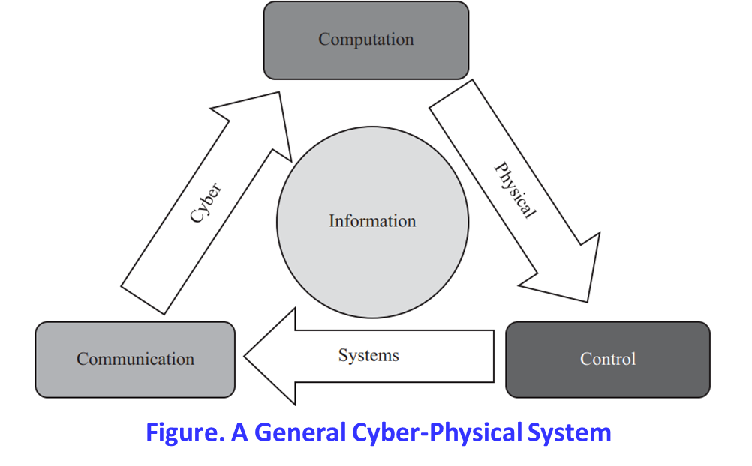
Introduction to CPS (Contd.)
It shows that the communication-enabled embedded systems monitor and control the physical processes and the computerized system is closely and seamlessly integrated with the dynamics of the physical processes.

Slide 11
Introduction to CPS (Contd.)
Realization of CPS: before realizing the future networks and CPS that are envisioned to be concurrent by nature, the following questions must be answered:
What aspects of those networking technologies should or could be important in large-scale networks?
Are they compatible with global networking ?
How are distributed cyber-physical applications to be developed?
What are the implications for security measures ?
Can we mitigate security risks created by the possibility of disrupting the shared notion of time?
Can security techniques effectively exploit a shared notion of time to improve robustness?
Recently, it has been observed that CPS is basically the emergence of wireless networks
(such as WSNs) and the IoTs. CPSs have gained much attention from many vendors, researchers and manufacturers

Slide 12
Introduction to CPS (Contd.)
Essential Properties of CPS
CPS expects to provide cyber capabilities to every component in the physical world that is supposed to be a resource constraint
CPS is an intensely integrated computation with physical processes
CPS is usually designed and networked at multiple and extremely wide scales. Therefore, it is considered as networks, which include both wired and wireless domains
CPSs are strictly constrained by spatiality (Geographical Constraints) and real-time capacity
Dynamically reorganizing/ reconfiguring. CPSs, as very complicated and large-scale systems, must have adaptive capabilities
Closed-loop control and high degrees of automation. CPSs favor convenient man–machine interaction, and advanced feedback control technologies widely apply to these systems
The CPS operations must be dependable and certified in some cases. On the other hand, reliability and security are also necessary for CPSs because of their extreme scales and complexities

Slide 13
CPS Concept and Requirements
A cyber-physical system (CPS) integrates computing, communication and storage capabilities with monitoring and/or control of entities in the physical world, and must do so dependably, safely, securely, efficiently and in real-time
It is quite clear that CPS is definitely not similar to the traditional or existing embedded systems, including real-time systems
Properties that define them as cyber-physical integration, which are as follows
Cyber/ Communication capabilities in every physical component available
Networked at various multiple and huge scale
Reconfiguring and reorganizing with respect to the dynamics of the environment
The control loops must be close with high degrees of computation and automation
The certified and dependable operations are key elements in some cases
The physical and cyber components are integrated for initially learning and later on adaptation purposes
CPSs are expected to provide high-performance, self-organized, auto-assembly operations

Slide 14
CPS Concept and Requirements (Contd.)
As for other communication and information systems, CPSs are also distinguished by the following basic properties:
1. Operability/ Functionality
2. Performance Metric
3. Security & Dependability
4. Cost Effectiveness

Slide 15
CPS Concept and Requirements (Contd.)
Expected Features of CPS
CPS will support the input from the physical environment and then feed back to the physical environment in the presence of the secured channels for communication
CPS will guarantee a combined management approach and distributed controlling mechanism
CPS will also meet the real-time communication and performance requirements
Different from current embedded systems, a wide geographical coverage without the physical security components will be supported by CPS
Forthcoming technology, known as System of Systems (SoS), will be as a result of CPS
A system of systems (SoS) brings together a number of systems to perform a task or to accomplish a purpose that none of the constituent systems can perform or accomplish on their own.

Slide 16
CPS Architecture
To date there is no identified or standard concept of a CPS
However, in general, the CPS is referred to as the combination of the dynamic physical world and the cyber world
In the case of CPS, it makes a distinction between the physical and cyber world and processes the data by computers
The proposed three tier architecture consists of the
Environmental Tier (First)
It is made up of various physical devices and a target environment with end users having the devices and being a part of their associated physical environment
Service Tier (Second)
It is composed of a classic computing environment with several services and cloud computing
Control Tier (Third)
It is designed to receive the monitored data, which are collected via sensors, to make further control decisions. Also, control tiers help the CPS to find the right services by a service-consulting framework and invoke the services on the physical devices

Slide 17
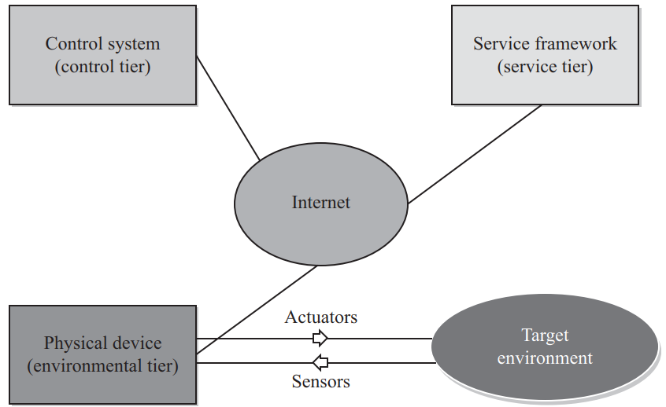
CPS Architecture (Contd.)
Fig. Three tier CPS Architecture

Slide 18
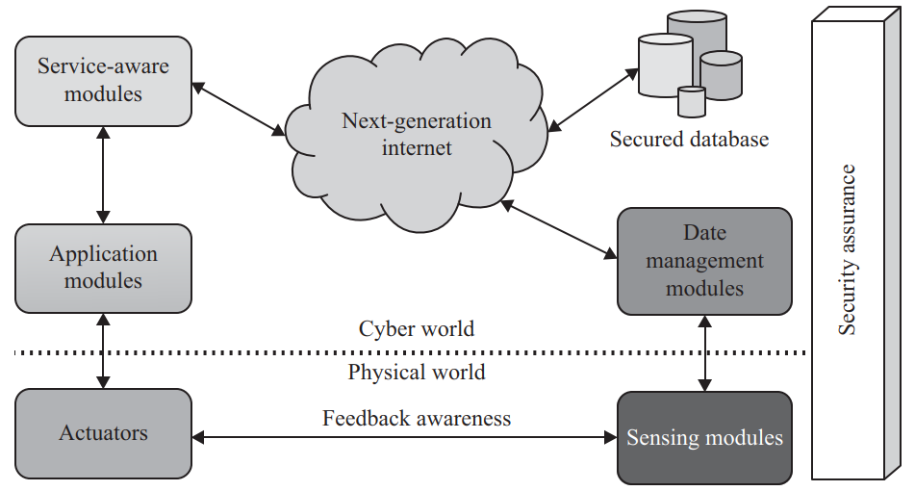
CPS Architecture (Contd.)
Recently a new architecture has been designed to meet the basic requirements of future CPS systems and their applications
Fig. Advanced CPS Architecture

Slide 19
CPS Architecture (Contd.)
The aim of the sensing module is to capture the data from the environment
The sensing module supports multiple networks
For example, in a Wireless Sensor Network (WSN) each sensor node is equipped with a sensing module for real-time sensing
Other network nodes can also operate with a part of this module in different scenarios
In case of the Vehicular Cyber-Physical System (VCPS), VANETS nodes (i.e., CARS) can be equipped with a sensors to capture the data
In case of Human Centric Cyber Physical System (HCPS), using Body Area Network (BAN) sensors attached to patients are equipped with sensing module nodes to enable real-time control

Slide 20
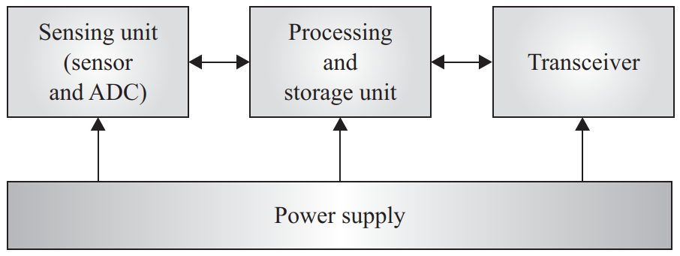
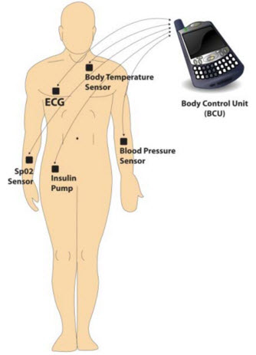
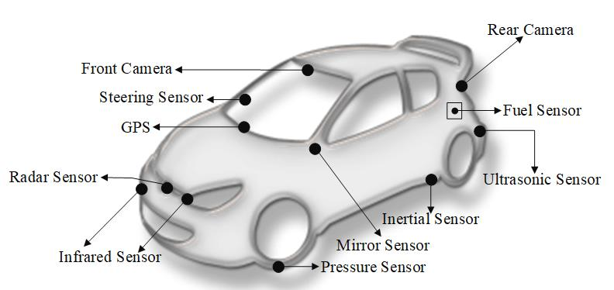
CPS Architecture (Contd.)
Fig. Typical Sensor Node
Fig. Body Area Networks
Fig. Sensors in AVs

Slide 21
CPS Architecture (Contd.)
Data Management Module (DMM) consists of the Computational Devices and Storage Media
This provides heterogeneous data processing such as Normalization, Noise Reduction, Data Storage and other Functions
DMM is considered as the bridge between the dynamic environment and services as it is collecting the sensed data from sensors and forwards the data to service-aware modules (SAM) using Next-Generation Internet (NGI)
A common feature of the emerging NGI is the ability for applications to select the path, or paths, that their packets take between the source and destination. This dynamic nature of internet service is required for designing CPS
Unlike the current internet architecture, where routing protocols find a single (the best) path between a source and destination, future internet routing protocols will need to present applications with a choice of paths

Slide 22
CPS Architecture (Contd.)
In the Application Module
Several services are deployed and interact with the NGI Simultaneously, information is saved in a secure database for QoS support
The database is stored locally and simultaneously on cloud platforms to keep data safe.
We can use a concept of NoSQL for saving data
NoSQL systems have a variety of different features, there are some common ones
First, many NoSQL systems manage data that is distributed across multiple sites
This saved data over the cloud system can be accessed from anywhere followed by authenticated access.

Slide 23
CPS Architecture (Contd.)
Actuators and the Sensing Modules are two different electronic devices which interact with the physical environment
The actuator may be a physical device, a car, a lamp or a watering pump
It receives the commands from the Application Module, and executes

Slide 24
CPS Architecture (Contd.)
The security assurance part is inherently important in a whole system, from the Access Security, Data security to Device Security
Security of CPS can be divided into the following three phases
Awareness Security: which is to ensure the security and accuracy of the information collected from the physical environment
Transport security: which is to prevent the data from being destroyed during the transmission processes
Physical Security: such as safety procedures in servers or workstations
Feedback Awareness: is one of the advanced level services to minimize the data processing by communication between sensor and actuator for executing required actions directly

Slide 25
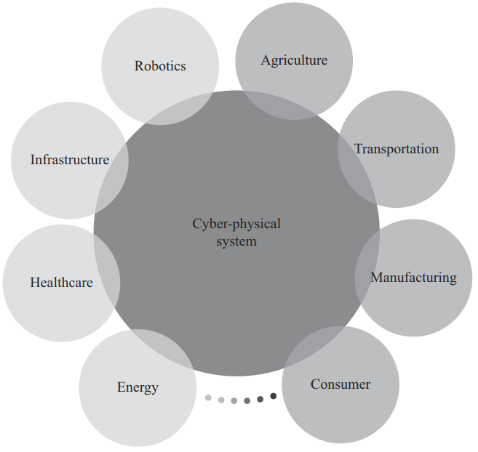
CPS Applications
CPS can be used in a wide range of applications, including Intelligent Transportation, Precision Agriculture, Health CPS, Water and Mine Monitoring, Aerospace and so on
Applications of Cyber-Physical Systems
Fig. Applications of CPS

Slide 26
CPS Applications (Contd.)
CPS for Vehicular Environments
The rapid increase in the number of the vehicles on the roads brings several challenges
Air pollution, traffic congestion, safety issues. Therefore, much effort is required to improve the driver’s experience and road safety
It is expected that soon
Roads will be significantly aided by the next-generation intelligent vehicle with the support of an Intelligent Transportation System (ITS), inter-vehicle sensing and advanced computing.
The technologies like ITS, inter-vehicle sensing, and advanced computing will be widely used to provide protected air traffic, a secured railway traveling experience and automatic car control for safety throughput
Similarly, other applications for CPS include the Vehicular CPS (VCPS), which is not a new concept. For instance, VCPS may refer to a wide range of Transportation Management Systems that are highly integrated and should be highly accurate, real-time and efficient

Slide 27
CPS Applications (Contd.)
CPS for Vehicular Environments
Due to modern computing technologies such as electronic circuits, sensors, computers and wireless networks, traditional transport modules are becoming more intelligent and effective
NAHSC (National Automated Highway System Consortium) is studying and developing an independent high-speed system known as AHS (Automated Highway System), whose aim is to achieve more intelligent and secure traffic.
American National Science Foundation (NSF) projects is CarTel, originally developed by MIT. The main objective of the CarTel project is to combine sensing and mobile computing via wireless networking
Moreover, the CarTel project supports applications designed for easy data collection, data processing, delivery, data analyzing and its visualization from sensors located on/ in vehicle units

Slide 28
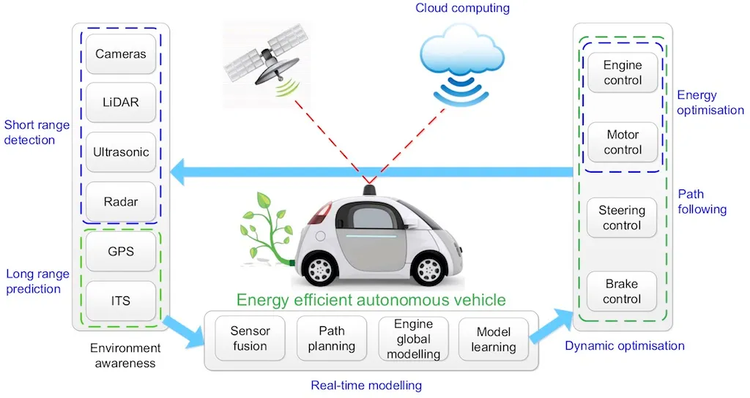
CPS Applications (Contd.)
CPS for Vehicular Environments
Physical Process
Physical Process
Communication
Computation

Slide 29
CPS Applications (Contd.)
CPS for Agriculture
CPS plays a significant role in agricultural domain to improve crop production and quality
In addition, human input has reduced, and currently numerous experimental studies are illustrating the benefits of WSNs in the agriculture sector
However, great accuracy in agriculture is demanded to meet the global demands of food consumption
The main goal of achieving accuracy in agriculture is to reduce wastage during the entire agricultural cycle and to increase crop yield (i.e., from preparation of the crop field through to harvesting)
To achieve above goal
we continuously evaluate the field crop with respect to macro and micro-level weather and climate information
Also, we need to consider the effect of natural components in the soil, the fundamental geographic of farmland and so on, throughout the crop production cycle

Slide 30
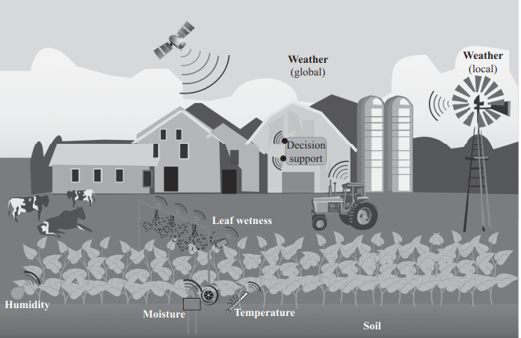
CPS Applications (Contd.)
CPS for Agriculture

Slide 31
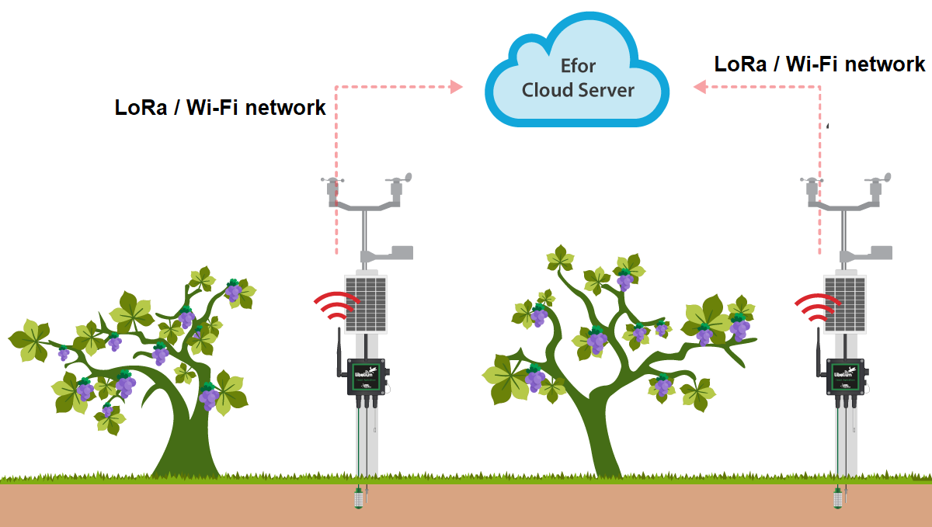
CPS Applications (Contd.)
CPS for Agriculture
WiFi, BLE, LoRa, SigFox, NB-IoT
WiFi, BLE, LoRa, SigFox, NB-IoT
Soil Moisture, Temperature, Air Quality Sensors, Accelerometers, Color Sensor, Camera
Lamps, Water Pumps, Sprinklers, Chemical Spraying Systems

Slide 32
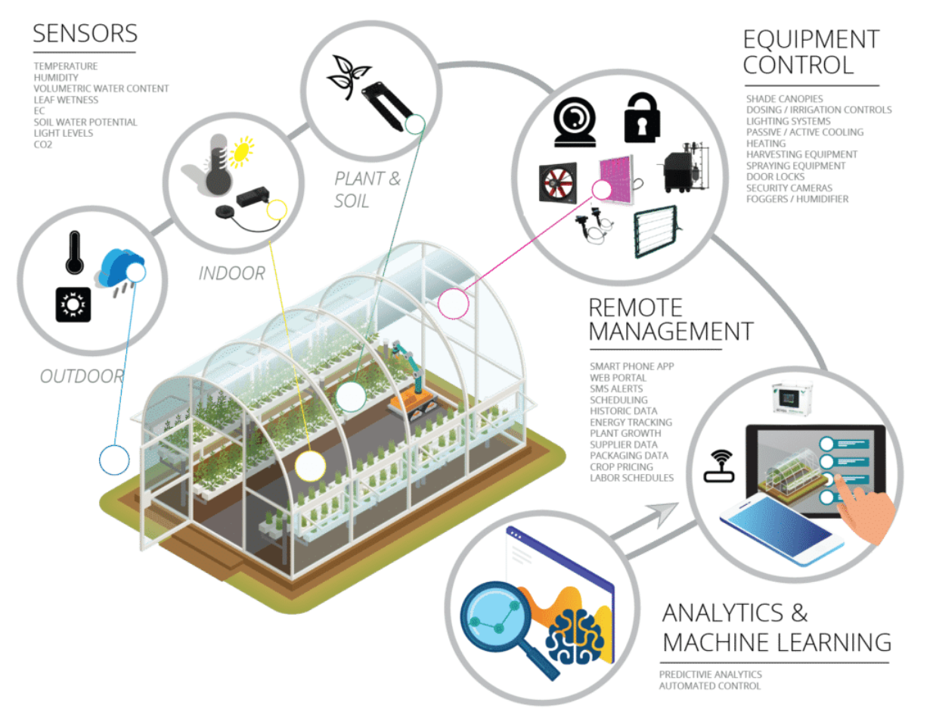

Slide 33
CPS Applications (Contd.)
CPS for Health and Medical Sciences
The potential of embedded network and software connectivity, a rapid transformation is under way in the medical industry
In near future, distributed systems will control and monitor the multiple aspects of a patient’s physiology; hence, the standalone systems designed, certified and used independently for different purposes for the treatment of patients will be replaced
The modern medical device systems, which combine embedded software-controlled devices, networking capabilities and complex physical dynamics revealed by patient bodies, can be classified as a distinct class of CPSs termed medical cyber-physical systems (MCPSs)

Slide 34
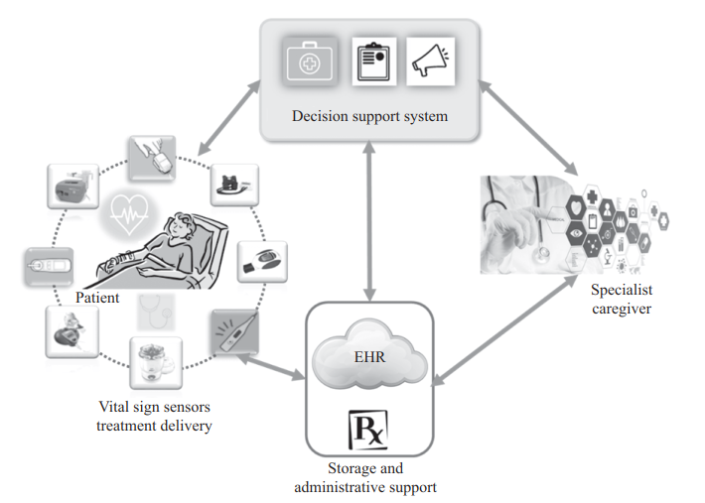
CPS Applications (Contd.)
CPS for Health and Medical Sciences
Fig. A Conceptual Overview of the MCPS

Slide 35
CPS Applications (Contd.)
CPS for Health and Medical Sciences
Two large groups of devices that are used in MCPSs can be categorized on the basis of their
Primary Functions: monitoring devices, which provide the patient’s physiologic state information, such as the oxygen-level monitors, heart rate, etc.
Delivery Devices: which target changing the patient’s physiologic state through therapy, such as ventilators and infusion pumps
In MCPSs, the decision support or administrative support entities are directly fed the data collected through the monitoring devices, each of which serves a complementary and different purpose
A medical set-up in a hospital, different administrative units, including electronic health records (EHRs) and various pharmacies. The main objective of any medical care unit is to manage patients’ health and treatment information which is collected periodically.

Slide 36
CPS Applications (Contd.)
CPS for Health and Medical Sciences
The periodic data collection and its management is important for today’s health challenges and issues such as dealing with the older population and the rapid rise in the number of people with chronic symptoms such as diabetes and asthma
Decision making entities can process the collected data and can generate alarms for various situations that may require medical attention. Such alarms are essential to let clinicians know when the patient’s state has deteriorated and what information is relevant to treat them properly.
The Medical caregivers can then analyze the information provided and use it properly to deliver a clear message to devices to initiate any necessary treatment immediately. In this way, we bring the caregiver into the controlled loop around the patient
Alternatively, decision-making entities can utilize a smart controller that analyzes the received data from the monitoring modules and can estimate the state of the patient’s condition, and it is expected that it may start the treatment autonomously. Those treatments may include drug infusion by releasing commands to drug delivery smart devices, thereby closing the controlled loop.

Slide 37
CPS Applications (Contd.)
CPS for Health and Medical Sciences
However, building such MCPSs brings a significant number of challenges and issues which have to be addressed. These include the following
Software plays a vital and essential role in designing medical devices. Many functions traditionally implemented in hardware, including safety interlocks, are now being implemented in software. Thus, high-confidence software development is absolutely essential to ensure the safety and effectiveness of medical CPS
Since medical devices should include communication interfaces, it is also essential to ensure that integrated medical devices are effectively safe, secure, and can ultimately be certified.
The patient information exchanged while the device is interoperating may not only ensure a better understanding of the general health conditions of the patient but can also enable early detection of sicknesses. As a result, the generation of effective and smart alarms is imperative in case of emergency situations

Slide 38
CPS Applications (Contd.)
CPS for Health and Medical Sciences
Computing intelligence should be a property of MCPS. Going forward, that property can be used for increasing the authority of the system by enabling actuation of therapies based on the patient’s current health status
MCPS collects very critical medical data and also aims to manage that data. Therefore, any unauthorized access or tampering with this information can have severe consequences for the patient’s health and can breach or break privacy laws, resulting in attempted abuse, discrimination and physical harm
The demonstration of dependability and cost-effectiveness for medical device software is the backbone of complex and safety-critical MCPSs. Certification of such medical devices provides a way of achieving this goal. Verification is therefore an essential requirement for the eventual viability of MCPS devices and is, therefore, an important challenge to be addressed.

Slide 39
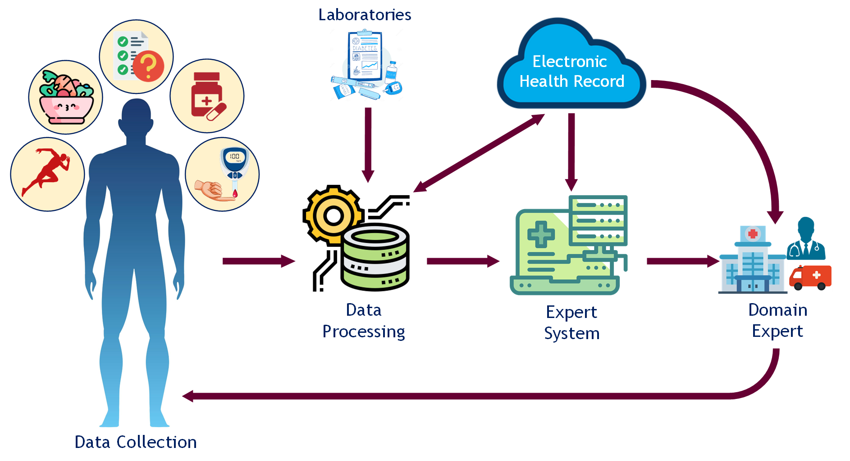
CPS Applications (Contd.)
CPS for Health and Medical Sciences
Fig. Architecture of Personalized Medicine in Managing the Diabetes

Slide 40
CPS Applications (Contd.)
CPS for Smart Grid
Power grid is defined as the network which interconnects the power generation, transmission and distribution unit
Nowadays, consumers’ energy requirements are met through a few central power stations, following the typical centralized approach
However, due to the development of renewable energy resources, in the future we can expect users to also produce energy – hence the term ‘prosumers’. Thus consumers can interchange the consumer/producer roles
Smart Grid using CPS is achieved through a complex infrastructure, SoS, taking care of a number of characteristics such as geographical distribution, independent operational and managerial elements, interdisciplinary nature, highly heterogeneous networked systems as well as their behavior and evolutionary development
An efficient management and energy utilization requirement is the key driving force of smart grid, such as to obtain granularity in the monitoring and management in the utilization of both local and global available resources

Slide 41
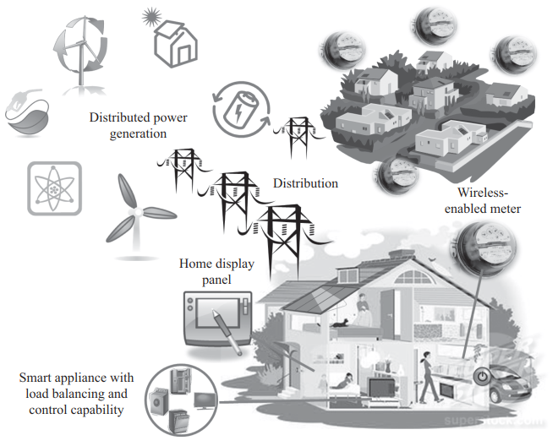
CPS Applications (Contd.)
CPS for Smart Grid

Slide 42
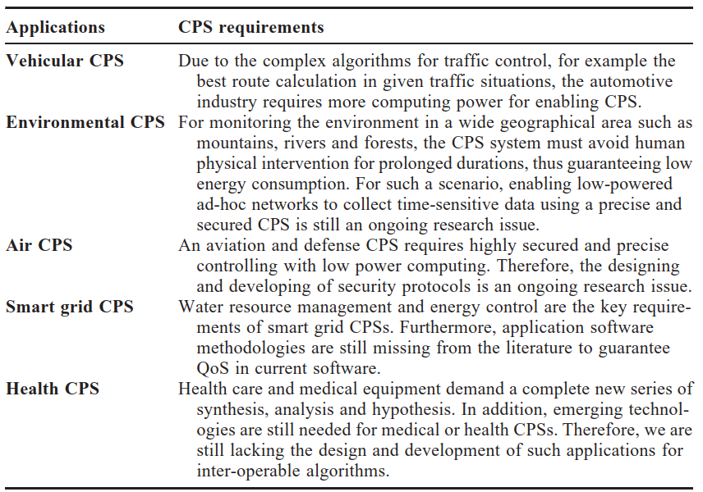
CPS Applications (Contd.)
More Computing
Low power Devices
and Security
Low power Devices, Security
Application Software's, QoS
Use of Emerging technologies, Inter-operable Algorithms

Slide 43
Future aspects of CPS
The future research challenges of the CPS domain which is still at an early stage
Architectures and Abstractions: In order to let any CPS communicate, control, compute and integrate between physical and cyber properties, we need to develop an innovative approach and define abstracts to formulate new architectures. Those architectures may allow the fusion and integration of a set of various heterogeneous systems with different properties that composed the CPS in an integrated, robust and efficient manner
Network control and Distributed Computations: Here we refer to developing new frameworks, methods, algorithms and Software Development Kits (SDKs) related to event-driven and time-dependent calculations (computing). Moreover, we also lack software tools, various time-delay tolerance, malfunctions, runtime configuration and rapid decision support for distributed systems such as CPS. Therefore, we should take into account the satisfactory interaction of the physical environment with highly reliable and secure but varying components, which later on take decisions on runtime autonomously.

Slide 44
Future aspects of CPS (Contd.)
Validation and verification: Any CPS system expects to be composed of such hardware and software modules that should outperform their current stage and must achieve a high level of re-configurability, dependability and certification when it is required. Hereafter, new algorithms, models, tools and methods are expected in order to validate the software components.

Slide 45
Future aspects of CPS (Contd.)
There are research challenges in the CPS field were highlighted by the CPS Steering Group in their report and are described in detail below:
The redesigning of abstract layers is required where those layers must include some physical concepts including energy and time. Those changes will relatively allow the fusion of computations/calculations together with the physical properties and physical system dynamics which are currently causing uncertainties in the implementation of CPS
Semantic foundations need to be developed for heterogeneous models of CPS. Also, various modeling languages are also required in order to describe the numerous associated logics of physics
Understanding and composing of a new heterogeneous system that tolerates the large amount of data. In addition, a networked system that fulfills a set of essential physical characteristics and has the ability to deliver the desired CPS functionalities in a more reliable fashion
The development of a technology for achieving the predictability in partially compositional properties

Slide 46
Future aspects of CPS (Contd.)
The modeling of a predictable and precise technology to be considered as a base foundation for integrating various systems in the future
Proposing a new infrastructure for swift design and automation of CPS
The design of a new series of flexible architectures, enabling CPS, ensuring the development of the nationwide and global effective systems
From the existing but unreliable modules, developing the architectures and modeling tools for a reliable and resilient CPS that must be able to withstand malicious attack from either the physical or cyber world

Slide 47
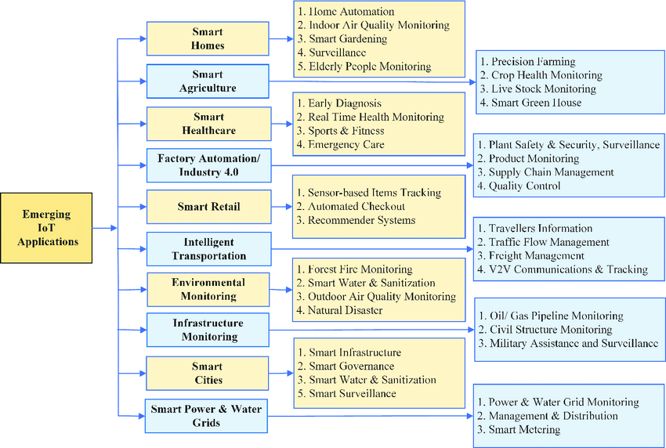
Application Domains

Slide 48
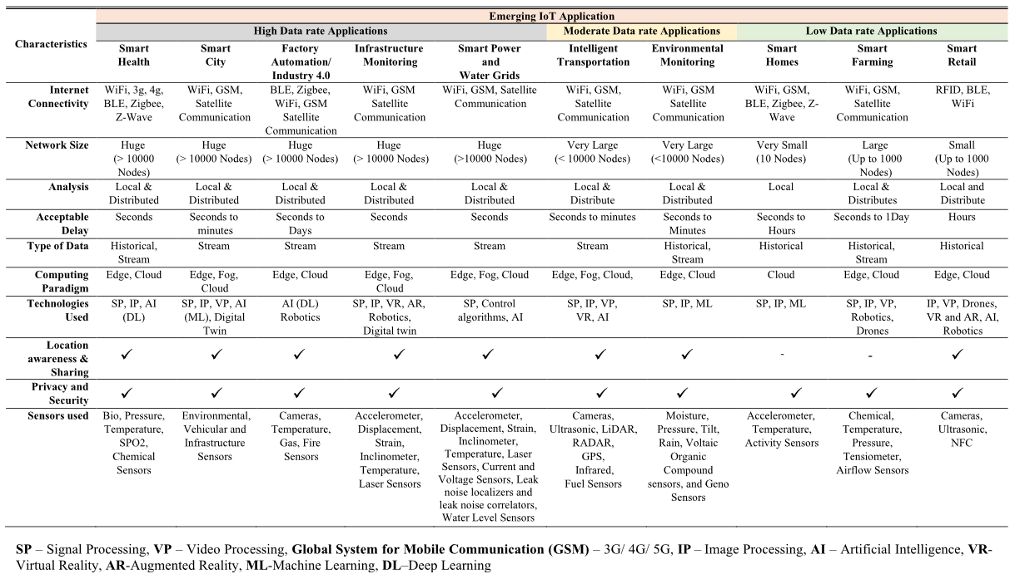
Application Domains (Contd.)

Slide 49


